Slide 1
UNIT -1 OBJECTIVES
E Commerce – E- Business Concepts and Issues

Slide 2
Defining e-business
Electronic business (e-business) can be defined as the use of the internet to network and empower business processes, electronic commerce, organizational communication and collaboration within a company and with its customers, suppliers, and other stakeholders

Slide 3
E-businesses utilise the internet, intranets, extranets and other networks to support their commercial processes.
Electronic commerce (e-commerce) is the buying and selling, marketing and servicing of products and services via computer networks.
Since e-business includes the process of transacting with suppliers and customers there is an overlap in activities with e-commerce

Slide 4
Kalakota and Whinston (1997) refer to a range of different perspectives for e-commerce:
1- A communications perspective – the delivery of information, products or services or payment by electronic means.
2- A business process perspective – the application of technology towards the automation of business transactions and workflows.
3- A service perspective – enabling cost cutting at the same time as increasing the speed and quality of service delivery.
4- An online perspective – the buying and selling of products and information online.

Slide 5
Traditional Commerce Model
Personal
Retail Outlets
Shopping Malls
Business
Individual Purchasing Agents
Based on ERP requirements

Slide 6
E Commerce Model
Personal
Web Based Retail Outlets
Amazon.com
BarnesAndNoble.com
Comparison Services
Shopper.com

Slide 7
E Commerce Model
Business
e-Procurement
Commerce One
Ariba
Industry Purchasing Portals
Airline Portal
TradeXchange
GM Supply Power (Commerce One)
Auto Xchange (Ford – Oracle)

Slide 8
Difference between E-business and E-commerce
Although the terms ‘e-business’ and ‘e-commerce’ are often used synonymously, the distinction between them lies in the broader range of processes in e-business that incorporates internal transactions within an organisation. These include transactions relating to procurement, logistics, supply chain management, payments, stock control and order tracking .

Slide 9
E-BUSINESS
E-business is the transformation of key business processes through the use of Internet technologies
Buying and selling electronically
Electronic procurement
Electronic distribution
Online customer service
Electronic marketing
Secure transactions
Automation of processes
Electronic collaboration

Slide 10
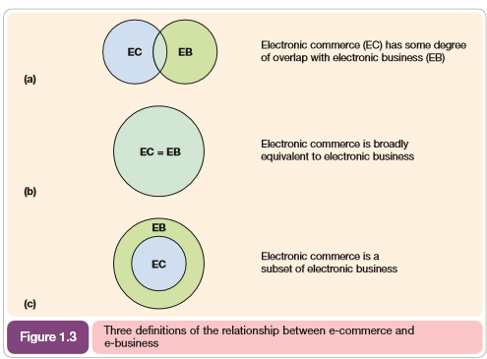

Slide 11
E- COMMERCE
E-commerce transactions between organizations can be considered from two perspectives: sell-side from the perspective of the selling organization and buy-side from the perspective of the buying organization
Sell-side e-commerce refers to transactions involved with selling products to an organization’s customer
Buy-side e-commerce
This refers to transactions to procure resources needed by an organization from its suppliers

Slide 12
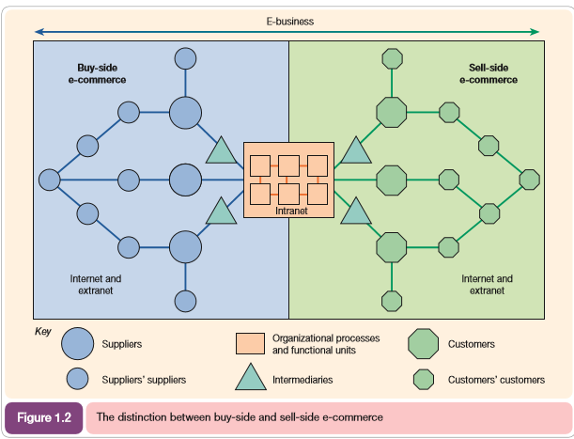

Slide 13
Different types of sell-side e-commerce
Not every product is suitable for sale online, so the way in which a web site is used to market products will vary. It is useful to consider the four main types of online presence for sell-side e-commerce, which each have different objectives and are appropriate for different markets

Slide 14
The four main types of site
Transactional e-commerce sites.
These enable purchase of products online. The main business contribution of the site is through sale of these products. The sites also support the business by providing information for consumers that prefer to purchase products offline. These include retail sites, travel sites and online banking services.

Slide 15
Services-oriented relationship-building web sites
Provide information to stimulate purchase and build relationships. Products are not typically available for purchase online. Information is provided through the website and e-newsletters to inform purchase decisions. The main business contribution is through encouraging offline sales and generating enquiries or leads from potential customers. Such sites also add value to existing customers by providing them with detailed information to help support them in their lives at work or at home

Slide 16
Brand-building sites
Provide an experience to support the brand. Products are not typically available for online purchase. Their main focus is to support the brand by developing an online experience of the brand. They are typical for low-value, high-volume fast moving consumer goods (FMCG brands) for consumers

Slide 17
Portal, publisher or media sites
Provide information, news or entertainment about arrange of topics.‘ Portal’ refers to a gateway of information. This is information both on the site and through links to other sites. Portals have a diversity of options for generating revenue, including advertising, commission-based sales, sale of customer data (lists).Social networks can also be considered to be in this category since they are often advertising-supported

Slide 18
Different types of e-commerce
Business-to-business (B2B)
Business-to-Consumer (B2C)
Business-to-government (B2G)
Consumer-to-consumer (C2C)
Mobile commerce (m-commerce)

Slide 19
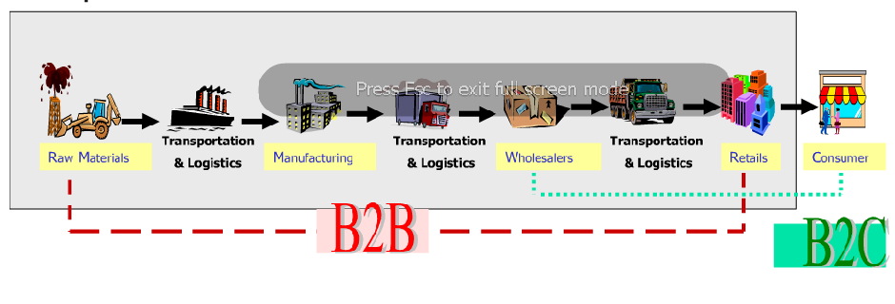
B2B and B2C Electronic Commerce
Notes:
This image shows B2B and B2C electronic commerce, and illustrates the difference between
the two types of EC.

Slide 20
What is B2B e-commerce?
B2B e-commerce is simply defined as ecommerce between companies. About 80% of e-commerce is of this type.
Examples:
Intel selling microprocessor to Dell
Heinz selling ketchup to Mc Donalds

Slide 21
What is B2G ecommerce?
Business-to-government e-commerce or B2G is generally defined as commerce between companies and the public sector. It refers to the use of the Internet for public procurement, licensing procedures, and other government-related operations
Example:
Business pay taxes, file reports, or sell goods and services to Govt. agencies.

Slide 22
What is B2C ecommerce?
Business-to-consumer e-commerce, or commerce between companies and consumers, involves customers gathering information; purchasing physical goods or receiving products over an electronic network.
Example:
Dell selling me a laptop

Slide 23
What is C2C ecommerce?
Consumer-to-consumer e-commerce or C2C is simply commerce between private individuals or consumers.
Example:
Mary buying an iPod from Tom on eBay
Me selling a car to my neighbour

Slide 24
What is m-commerce?
M-commerce (mobile commerce) is the buying and selling of goods and services through wireless technology-i.e., handheld devices such as cellular telephones
Mobile Ticketing
Information Services
Mobile Banking

Slide 25
E-Commerce 1
E-commerce in the period of 1995 – 2000 is known as e-commerce1
E-commerce 1 refers to that period in which , first widespread use of the web was their to advertize a product
Period in which companies started to invest in various e-commerce sectors
Ended in 2000 when stock market for dot companies has begin to collapse

Slide 26
Key Features of E-Commerce 1
Technology Driven
Disintermediation
Friction free commerce (in which information is equally distributed i.e. unfair competitive advantages are eliminated)
First movers advantages (firms who moved quickly into this to capture market share)
Network effect(value of a network grows by the square of the number of participants)

Slide 27
E-Commerce 2
E-commerce2 refers to the second period in the evolution of e-commerce from 2001 - 2006
Period in which concept of one world , one market, one price has weakened
Companies introduced new ways to differentiate their product and services
Eg price on books and cd`s vary by 20% and 50% respectively

Slide 28
Key Features of E-Commerce 2
Business Driven
Emphasis on earnings and profits
Stronger regulation and governance
Large firms entering into the market
Imperfect market

Slide 29
B-2-C Issues
Consumer purchasing is on the increase
acceptance of medium
trust
entry of big name creditors i.e. VISA
Service and support are critical
responding to e-mail inquiries
speed of response
volume capability
development of Web based systems
chat, e-mail, voice, self-help

Slide 30
B-2-C Issues
Service is the only means of differentiation. You must have price and selection.
adding content
creating links to other sites and services
personalizing the shopping experience

Slide 31
Security
What parts of the transaction are vulnerable and in need of protection?
data in transit
susceptible to modification, monitoring
web servers
http server security flaws
common gateway interfaces
customer data
credit card #’s stored in unencrypted server databases

Slide 32
Security
Advances in technology
html extension languages
greater control given to client system
more powerful programming languages like JAVA and Visual Basic
creation of credit card stealing applet
ability to access keystrokes
circumvent encryption

Slide 33
Security
Current security technology
Firewalls
Hardware and software to protect internal network from external attack
Location of web server is critical
Ahead of firewall
site is vulnerable but more user friendly and less cumbersome
data must be moved behind firewall for safety
Behind firewall
site is secure
data can be stored in server database

Slide 34
Security
Current security technology
Encryption
uses a public/private key pair to encode, authorize and decode data transmissions
data is encoded with a 48 to 126 bit random alphanumeric string
the message then can only be opened with the proper key located at the receiving end.
attempts are being made to use this public key technology to handle e-commerce transactions

Slide 35
Security
Current security technology
Encryption
SSL(Secure Sockets Layer)
authenticates server to client
SHTTP(Secure http)
authenticates both client and server
SET(Secure Electronic Transactions)
authenticates both client and server
securely carries payment through to bank

Slide 36
Security
Current security technology
3rd party payment systems
Cybercash
intermediary between merchant and customer/bank
merchant never sees customer credit card #
Digicash
digital tokens used like travelers checks
Virtual PIN
payments authorized via e-mail
difficult to intercept
credit card enrollment via phone

Slide 37
Security
Current security technology
Uniform standards must be developed and adopted to provide interoperability between systems.
Current payment systems require both the client and the server to register.
As standards are developed and proposed they must be easy to employ.
The entire transaction process must be incorporated; from the point of sale to the merchant to the bank and to the credit clearing house.

Slide 38
Security
Recent Developments
Microsoft fix
Active Setup download program which detects which files are needed and downloads relevant ones.
Microsoft files are automatically downloaded without approval
can specify download locations on user’s hard disk
vulnerable to denial-of-service attacks

Slide 39
Security
Recent Developments
Approximately 50% of organizations in a 1997 survey reported security breaches
up from 37% in the previous year
Nike.com
hackers seized domain name and routed users to an Australian site with anti-Nike messages
problem lasted for days due to ISPs’ use of cached versions of web pages to speed access

Slide 40
Privacy
The need for e-Marketing information
How do you turn browsers into purchasers?
How do you identify and retain repeat customers?
Who are the most profitable customers?
What marketing and promotional efforts attract them?
What content leads them to buy?
What products should be marketed through which channels?
You cannot personalize the shopping experience without some knowledge of the individual.

Slide 41
Privacy
How is this accomplished without jeopardizing privacy?
Technology has been focused on the marketer
consumers cannot manage personal data
Value, Control and Security
must have a perceived benefit
must have control as to how information is used
must be secure from theft, unauthorized modification
Demographics may be skewed
data could be misleading if only those willing to release information can be tracked

Slide 42
Privacy
Recent Developments
FTC involvement
from consumer protection standpoint, many online privacy policies are confusing, contradictory and ambiguous
changing its stance on self-regulation
congressional action possible

Slide 43
Privacy
Recent Developments
Essential Elements of Privacy Policies (FTC)
Notification defining privacy policies
Choice as to what data are collected and how it can be used
Customer access to data
Assurances of security from theft and improper usage
Effects on business
consumer choice could hurt many business models based on data warehousing and data mining
requirements for access would increase expenditures for technology and security

Slide 44
Privacy
Recent Developments
U.S./Europe hammer out safe harbor agreement designed to set policy for U.S. based firms to engage in e-commerce in Europe
establishment of an independent body and process for handling consumer complaints
compensation for damages from violations of privacy rules

Slide 45
Privacy
Recent Developments
Toysmart attempted sale of customer data as part of its bankruptcy liquidation.
Toysmart had a contract with TRUSTe a privacy watchdog group
TRUSTe is suing for breach of contract

Slide 46
Ethical/Legal Issues
B-2-B exchanges
Created to achieve marketplace efficiencies
Targets of Antitrust investigations
price signaling
collusion
freezing out competitors
Threat of one online marketplace for each industry via shakeouts and mergers

Slide 47
Ethical/Legal Issues
Methods to avoid legal issues
FTC recommendations
keep prices and trade secrets private
establish firewalls and procedures to keep competitors from learning one another’s prices from e-catalogs, bids and auctions
allow competitors to move freely from one marketplace to another
Identify which players will be hurt by an exchange
limit their exposure
where there are losers there will be litigation

Slide 48
Ethical/Legal Issues
Methods to avoid antitrust litigation
MetalSite.com
extensive controls and audits
require antitrust education for employees

Slide 49
Ethical/Legal Issues
Recent ethical and legal developments
Nike.com
a recent attack sent users to a Scotland based web hosting firm, tying up its system
web hosting company is threatening legal action against Nike and its internet provider
who bears the responsibility for such injuries?

Slide 50
Ethical/Legal Issues
Recent ethical and legal developments
Napster Inc. - Internet music sharing service
allows users to share MP3 files
suits brought on by record labels and music industry institutions for copy right infringement
company claims it is a ‘mere conduit’ for digital information
claims that fair use doctrine applies

